Slide 1
Refactoring to Cleaner Code
with @JayBazuzi
& @LlewellynFalco

Slide 2
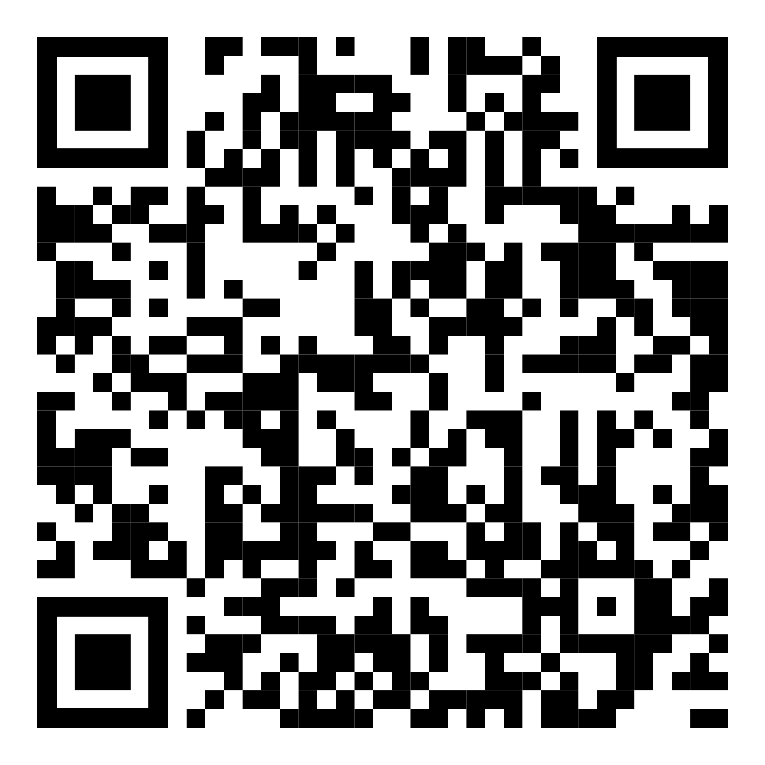
Resources
https://github.com/isidore/Talks/
blob/master/RefactoringToCleanerCode.md

Slide 3
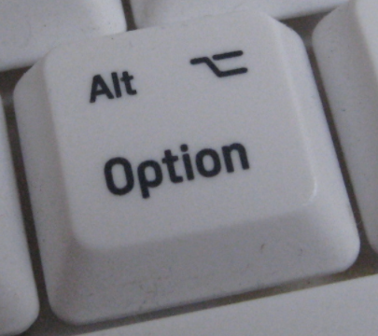
AnyDesk

Slide 4
Zoom
Camera On = I am present
Camera Off = I’ve stepped out of the room

Slide 5
Mob Programming

Slide 6
Why we Refactor?
Change
Change what the code does
Change how you use code
Insights
Gain an insight
Record an insight

Slide 7
Better Games
We work at an online game company that wants to improve the BigDiceGame experience.
Our product owner ‘has a few ideas’ and we want to make the code flexible to try things out

Slide 8
Some possible ideas…
Simpler
Maybe there are too many different options already
New Scores
Add scoring for Straight and 3 of a kind. Maybe some others
Different Levels
Easy, Normal, Expert versions with subsets of the rules

Slide 9
Let’s Refactor!

Slide 10
Checking For Behavior Preservation
Provable Transformation
Original
Code
Refactored
Code
===

Slide 11

Checking For Behavior Preservation
Original
Code
Refactored
Code
===
Provable Transformation

Slide 12
Original
Code
Refactored
Code
Provable Movement
Commit

Slide 13
Original
Code
Refactored
Code
Hand Refactor
Original
Code
Provable Refactor
Check source control for no changes
Refactored
Code
Ctlr + Z
Commit

Slide 14
Instead of extending the system to add your feature,
extend it to add extendibility
and then plug in your feature

Slide 15
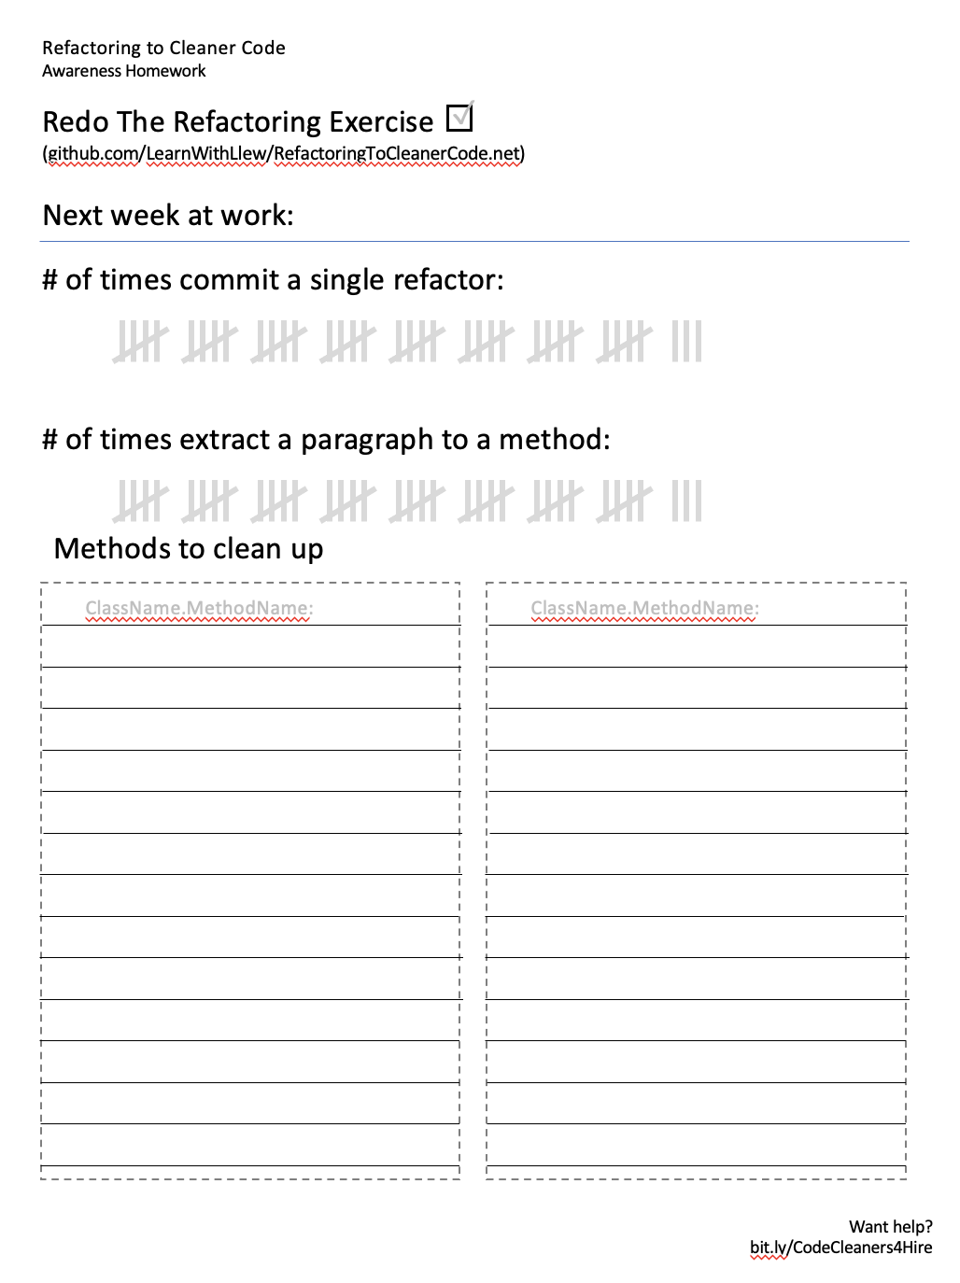
Homework
Making these behaviors stick

Slide 16
Resources
https://github.com/isidore/Talks/
blob/master/RefactoringToCleanerCode.md

Slide 17
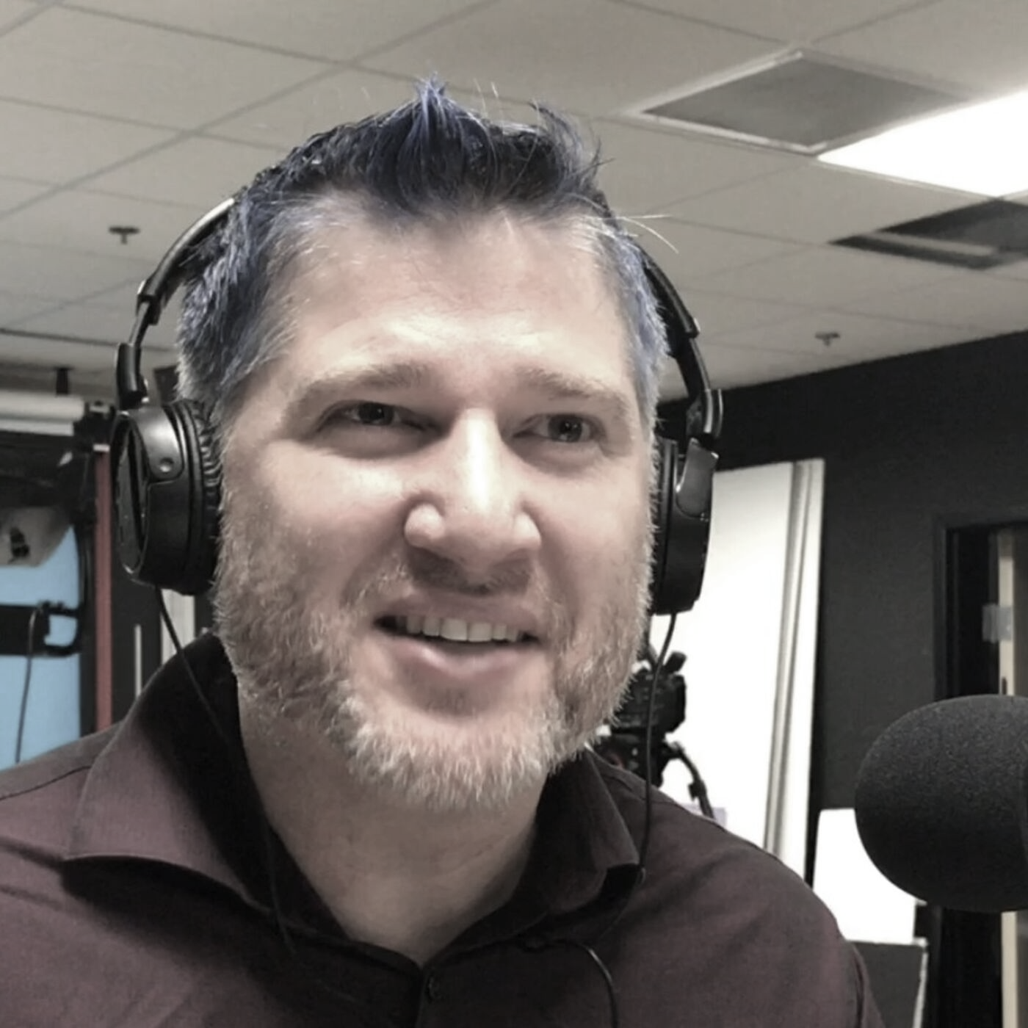
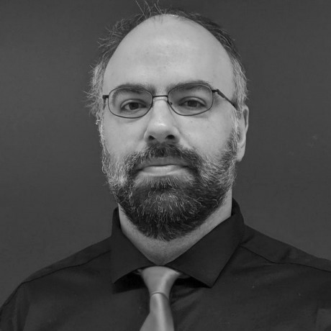
thanks!
Any questions?
Please connect through LinkedIn & Twitter
@LlewellynFalco
Llewellyn.Falco@gmail.com
@JayBazuzi
jay@bazuzi.com
Presentation template by SlidesCarnival

